Slide 1
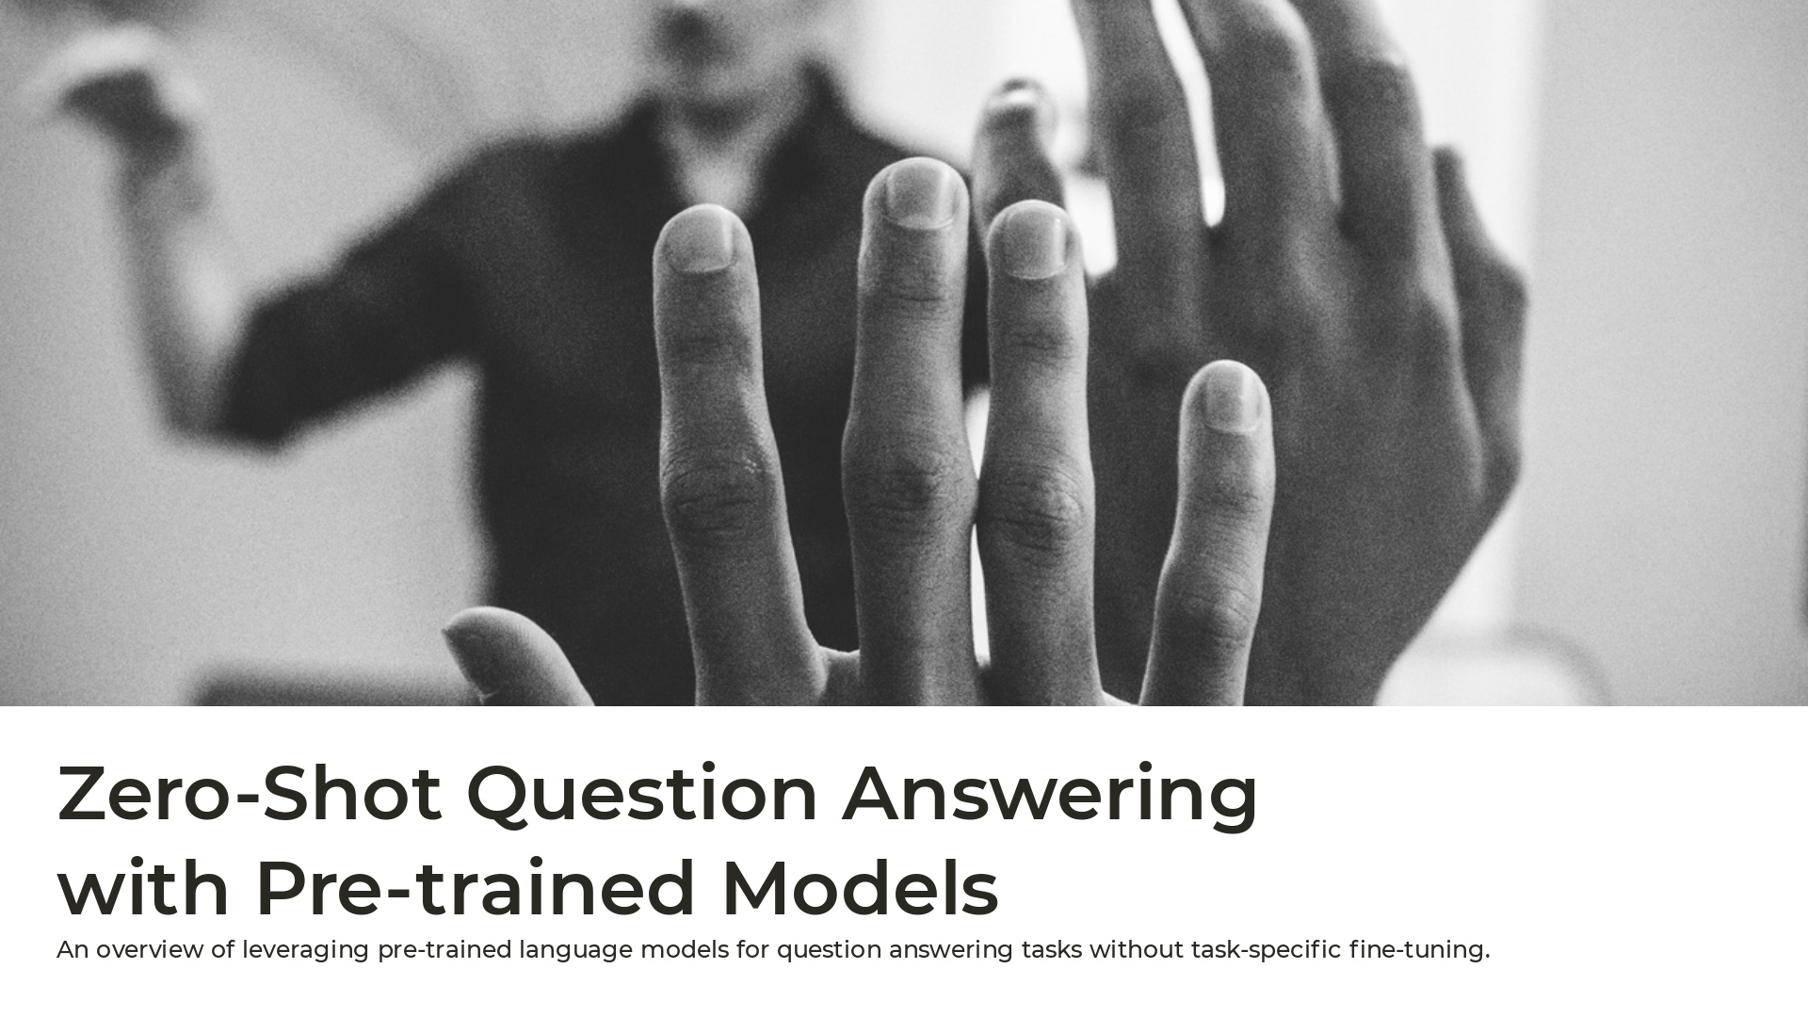
Notes:
Good afternoon, everyone. Today, I am presenting on a topic that is increasingly relevant in the field of artificial intelligence and natural language processing: 'Zero-Shot Question Answering with Pre-trained Models. In this presentation, we'll provide an overview of how we can leverage pre-trained language models for question-answering tasks without the need for task-specific fine-tuning. This approach, known as zero-shot learning, offers a powerful and flexible way to apply AI to a range of problems, cutting down on development time and enhancing performance across different domains.

Slide 2
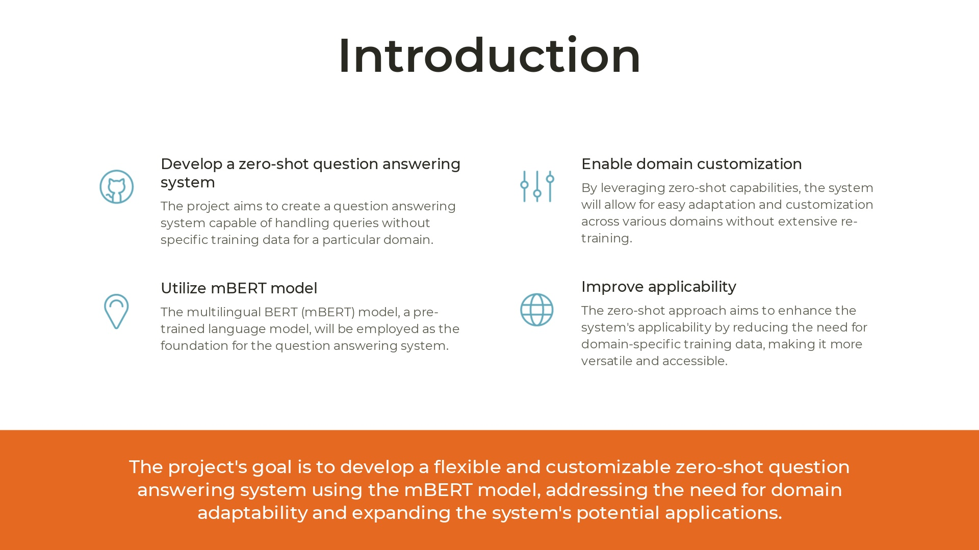
Notes:
"In this slide, we are looking into the primary goals of this project and its key components:Develop a Zero-Shot Question Answering System:The goal is to create a system capable of handling queries across different domains without requiring specific training data for each domain. This addresses a significant challenge in AI, allowing for greater adaptability and efficiency.Utilize mBERT Model:We'll be leveraging the multilingual BERT (mBERT) model, a pre-trained language model. This model will serve as the foundation for the question answering system, enabling it to understand and respond to a variety of queries.Enable Domain Customization:By employing a zero-shot approach, the system can be easily adapted and customized across various domains without extensive re-training. This is crucial for maintaining relevance and versatility.Improve Applicability: This approach aims to enhance the system's applicability by reducing the need for domain-specific training data. In turn, this makes the system more versatile, accessible, and applicable to a wider range of scenarios.

Slide 3
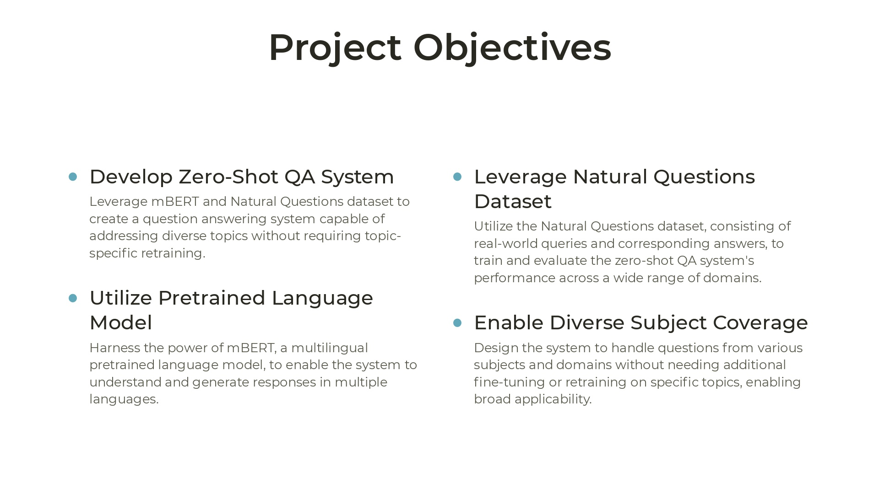
Notes:
In this slide, we into the key objectives of this project, which aim to create an effective and adaptable question answering system:Develop Zero-Shot QA System:The project leverages the mBERT model and the Natural Questions dataset to create a system capable of handling diverse topics without requiring topic-specific retraining. This is crucial for addressing a wide range of subjects efficiently.Leverage Natural Questions Dataset:The Natural Questions dataset consists of real-world queries and corresponding answers, making it an ideal training and evaluation resource. This allows the zero-shot QA system to perform effectively across various domains.Utilize Pretrained Language Model:The mBERT model, a multilingual pretrained language model, will be employed to enable the system to understand and generate responses in multiple languages. This significantly broadens the system's applicability and effectiveness.Enable Diverse Subject Coverage: The system is designed to handle queries from various subjects and domains without requiring additional fine-tuning or retraining on specific topics. This enables broad applicability and versatility, allowing it to adapt to different contexts seamlessly.

Slide 4

Notes:
an overview of related work in the field of zero-shot learning:Zero-shot learning aims to leverage large pre-trained language models, trained on massive text corpora, to perform tasks across different modalities, such as images, without requiring additional training data. By exploring this capability, we open up new avenues for multi-modal applications and create more efficient uses of computational resources. This not only demonstrates the versatility of zero-shot approaches but also highlights their potential to transform how we approach various AI and NLP tasks.

Slide 5
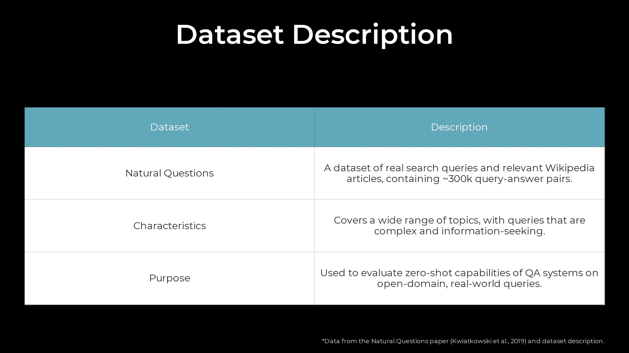
Notes:
In this slide, we'll explore the Natural Questions dataset in detail, which serves as a crucial resource for our project: Dataset: Natural Questions: This dataset consists of real search queries paired with relevant Wikipedia articles, encompassing around 300,000 query-answer pairs. This volume and diversity make it a robust resource for training and evaluating our system. Characteristics: The dataset covers a wide range of topics, with queries that are both complex and information-seeking. This range of topics ensures that the system is tested and trained across diverse subject matters. Purpose: The Natural Questions dataset is used to evaluate the zero-shot capabilities of QA systems on open-domain, real-world queries. This helps ensure that our system can handle a variety of questions effectively and efficiently.

Slide 6
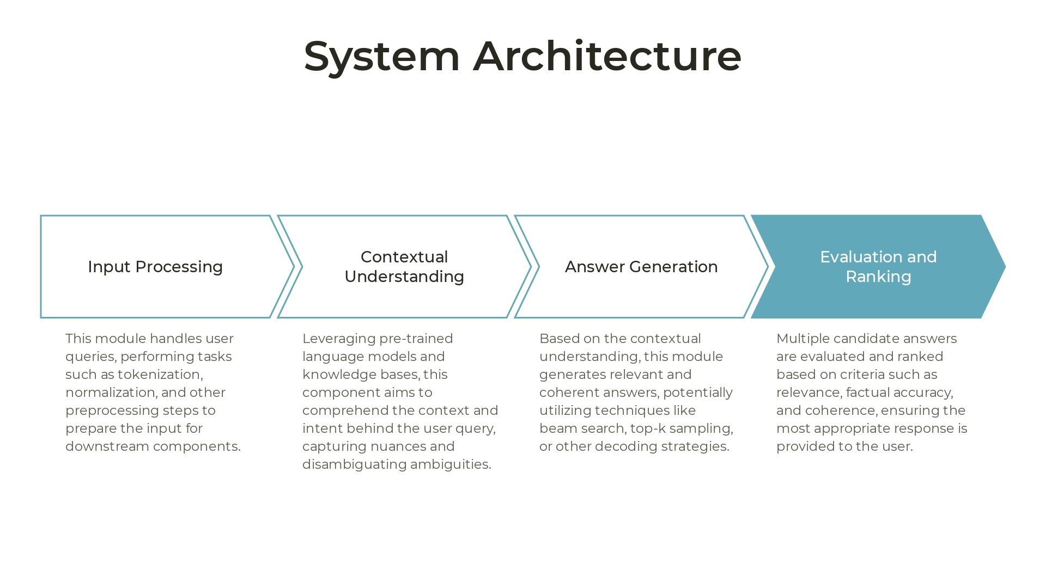
Notes:
In this slide, let's explore the architecture of our system, which consists of four key components: Input Processing: This module handles user queries, performing tasks such as tokenization, normalization, and other preprocessing steps. This prepares the input for downstream components, ensuring consistency and readability. Contextual Understanding: Leveraging pre-trained language models and knowledge bases, this component aims to comprehend the context and intent behind the user query, capturing nuances and disambiguating ambiguities. This step is crucial for providing accurate responses. Answer Generation: Based on the contextual understanding, this module generates relevant and coherent answers. Techniques like beam search, top-k sampling, or other decoding strategies may be utilized to ensure effective generation. Evaluation and Ranking: Multiple candidate answers are evaluated and ranked based on criteria such as relevance, factual accuracy, and coherence. This ensures the most appropriate response is provided to the user.

Slide 7
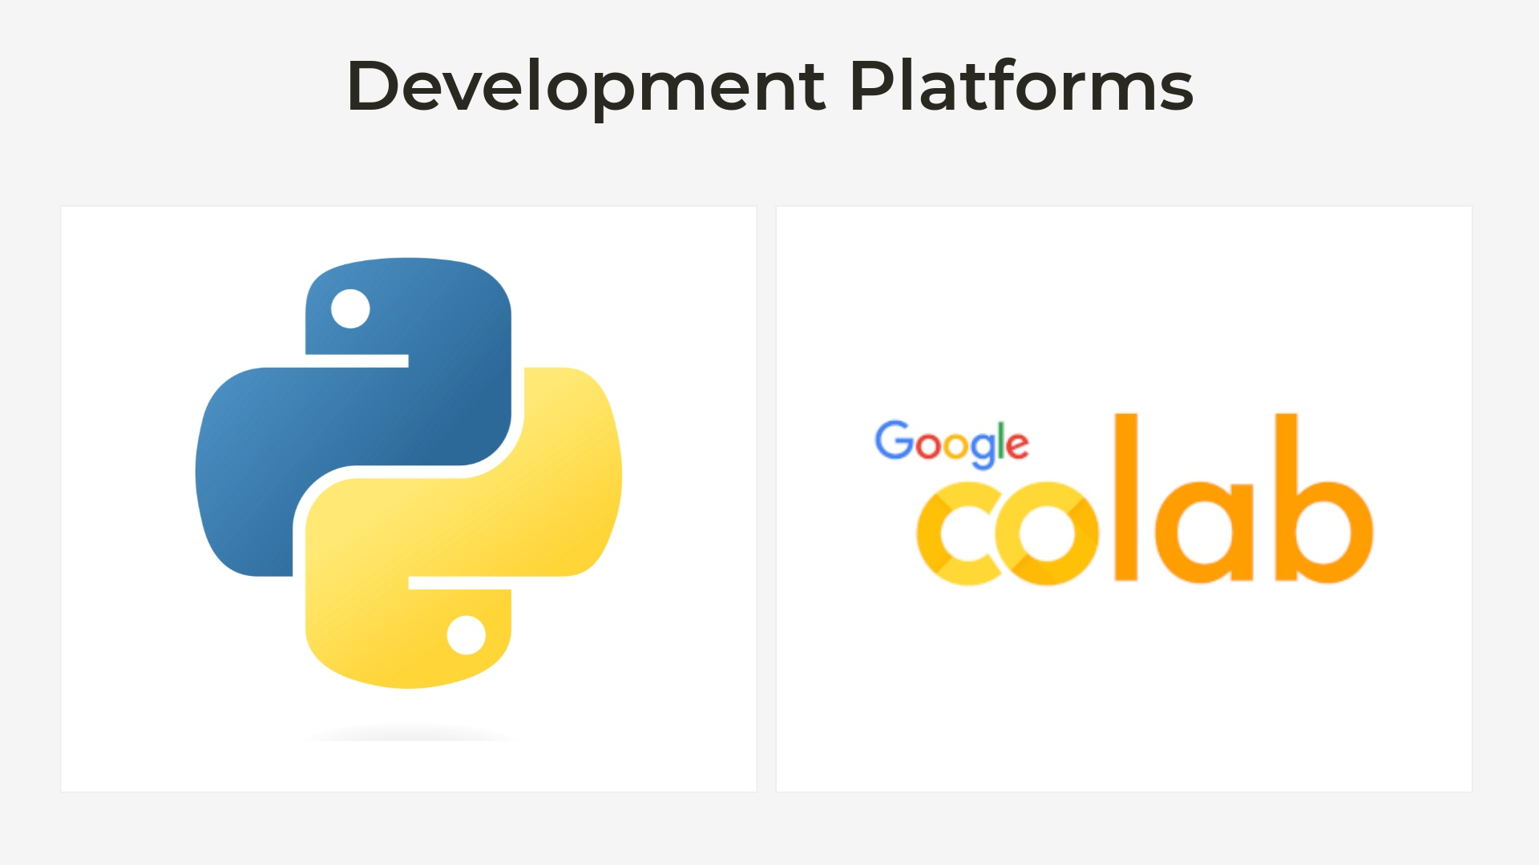
Notes:
In this slide, let's take a look at the platforms used for developing our zero-shot question answering system: Python: Python serves as the primary programming language for this project. Its extensive libraries, active community, and flexibility make it a suitable choice for handling various aspects of our system, from preprocessing and natural language processing to model training and evaluation. Google Colab: Google Colab offers a convenient and accessible environment for developing our system. With its built-in support for Python, pre-installed libraries, and free GPU access, it allows for streamlined development and testing, enabling us to iterate quickly and effectively.

Slide 8
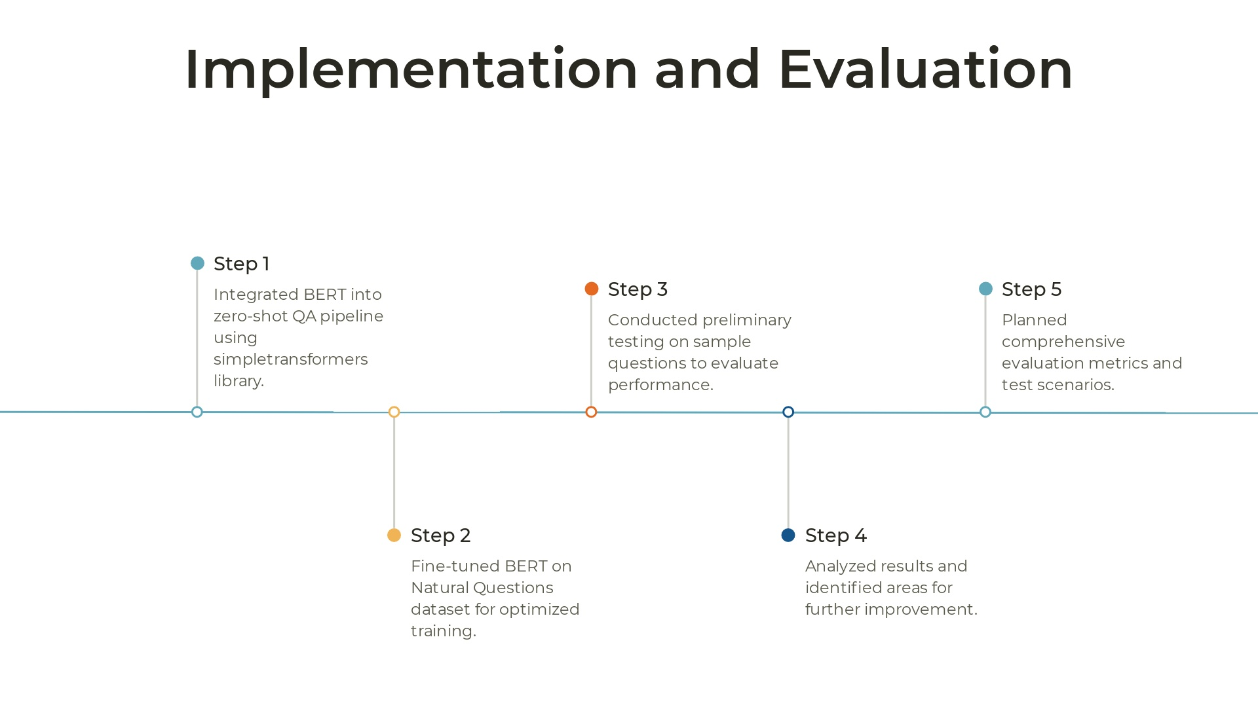
Notes:
In this slide, let's go over the steps involved in implementing and evaluating our project: Step 1: We integrated BERT into the zero-shot QA pipeline using the simpletransformers library. This provided a streamlined way to handle the model's functionality within our system. Step 2: We fine-tuned BERT on the Natural Questions dataset for optimized training. This helped the model adapt to real-world queries and refine its performance. Step 3: Preliminary testing was conducted on sample questions to evaluate the system's performance. This provided insights into how well the model handles various queries. Step 4: Results were analyzed, and areas for further improvement were identified. This step is crucial for refining the system's overall accuracy and robustness. Step 5: Comprehensive evaluation metrics and test scenarios were planned. This ensures thorough evaluation of the system's performance across a range of contexts.

Slide 9
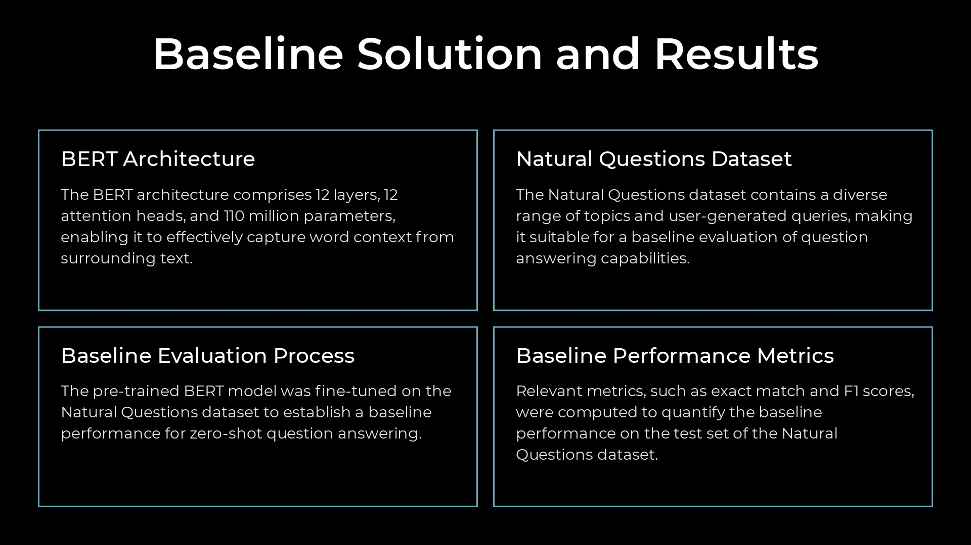

Slide 10
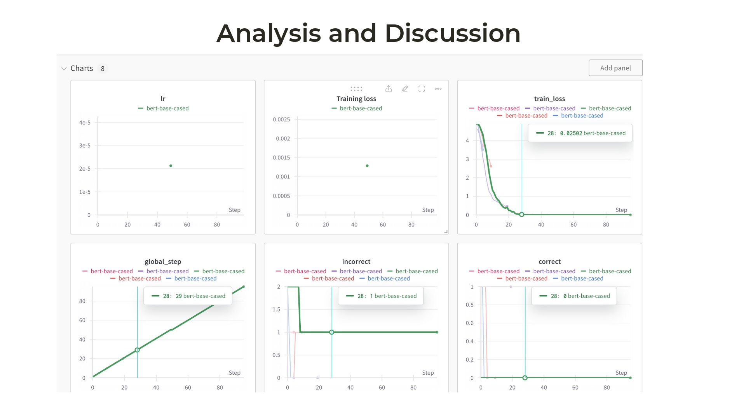

Slide 11
